Slide 1
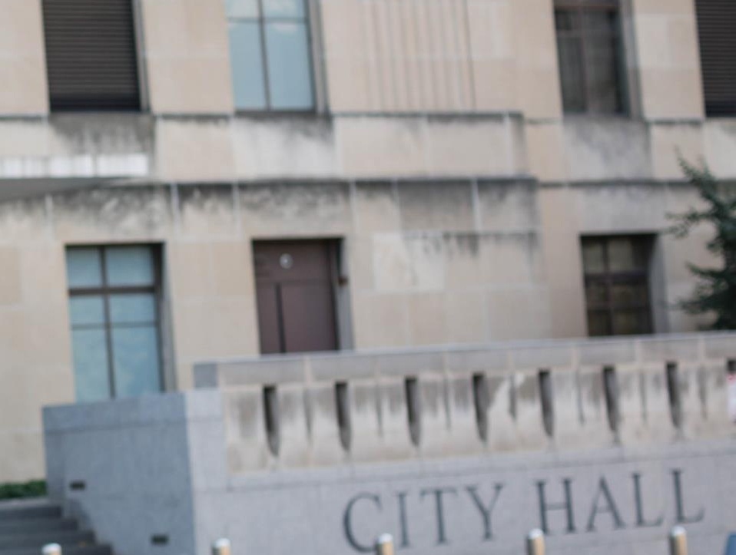



Update and Focus On
Credentialing

Slide 2



Alabama City/County Management Association
Summer Conference: Orange Beach, Alabama
ICMA Update | June 2017

Slide 3
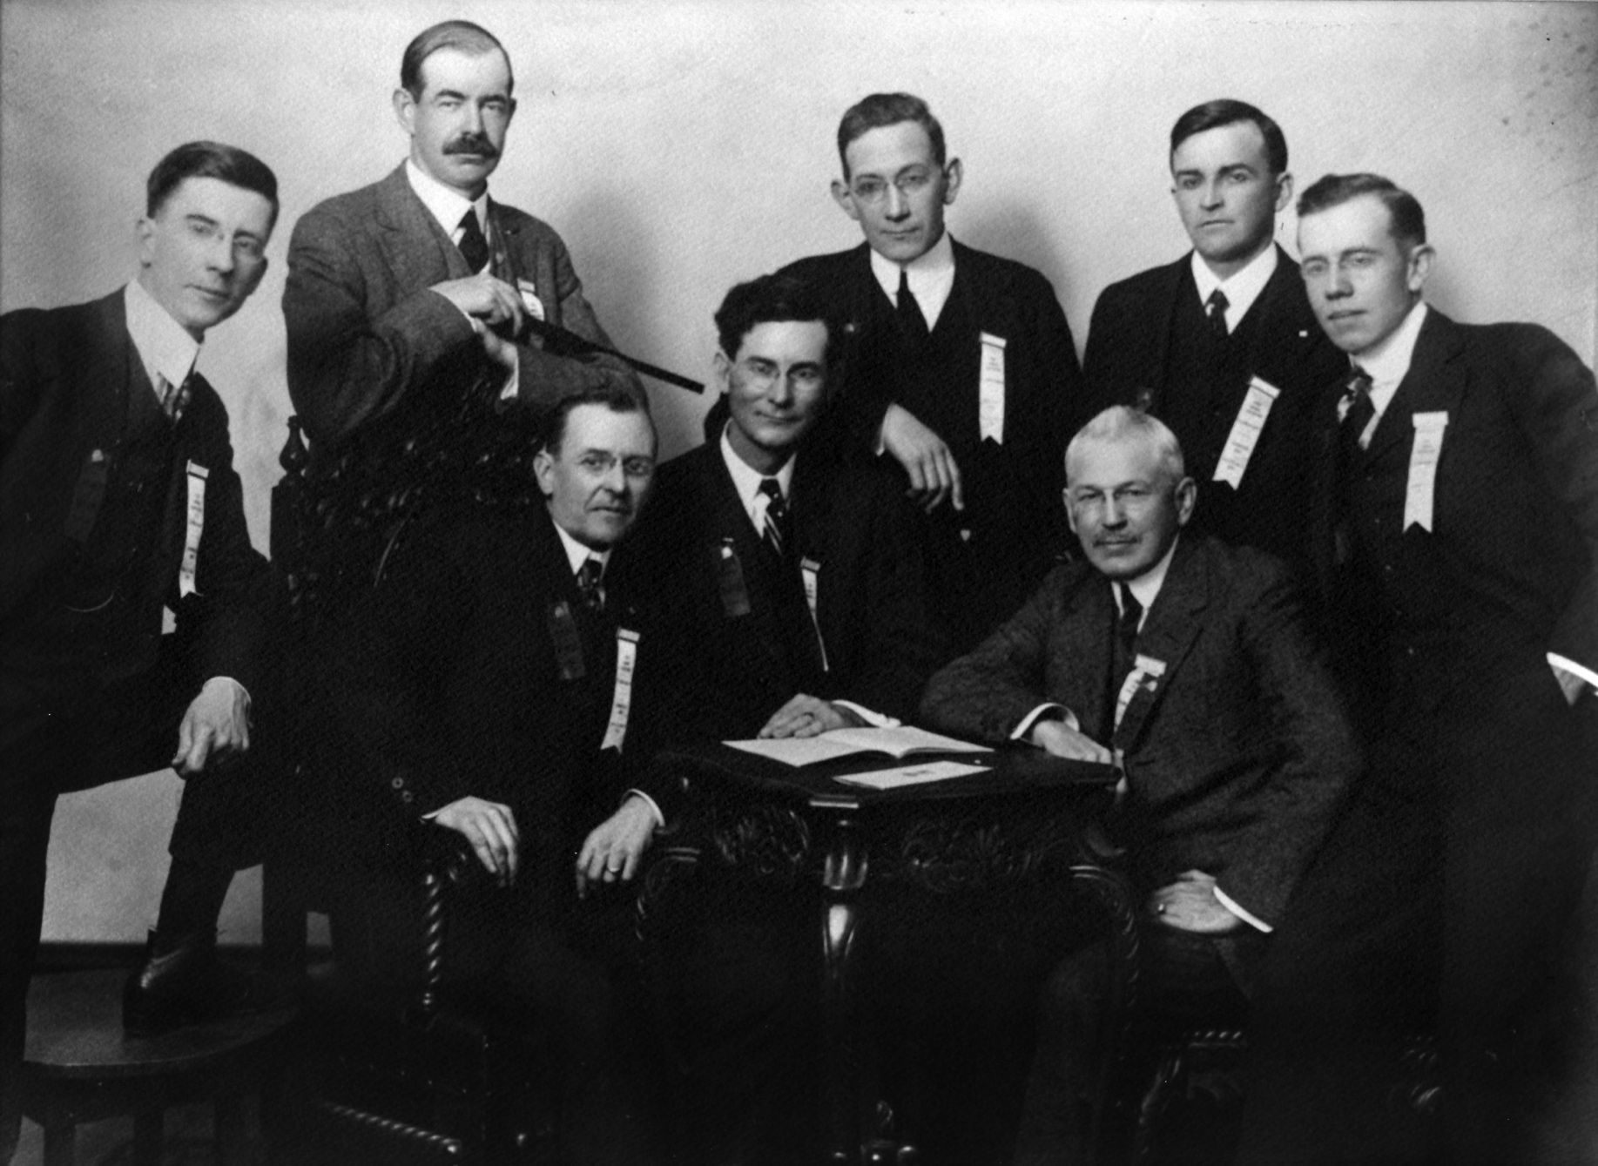
Empowering Vision
ICMA was founded in 1914 out of the reform movement in the U.S. and has become the premier local government leadership and management organization.

Slide 4
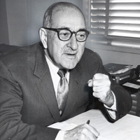
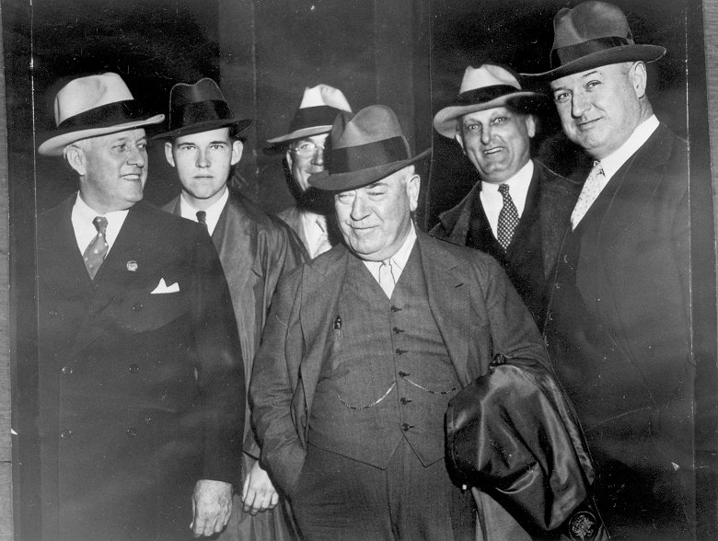
A Legacy of Legendary Professionals
LP Cookingham helped to stop the corruption in Kansas City when it was under the influence of the Pendergast political machine

Slide 5
Ethics and Professionalism
What makes people professionals?
Professions are characterized by practices,
norms or values, and perspectives.
Educational levels, client recognition, professional identity, professional culture, a code of ethics, formal measures of competence, and professional sense of discretion.
Local government management is distinguished by its generalist nature and the importance it places on ethical behavior.

Slide 6
State Associations
ACCMA is one of 46 state affiliates of ICMA in the United States.

Slide 7
2017 FOCUS
Membership & Benefits
Ethics
Leadership & Professional Development
Strategic Planning
Future of Professional Management

Slide 8


2017 ICMA Strategic Plan
Mission
Vision
Values

Slide 9

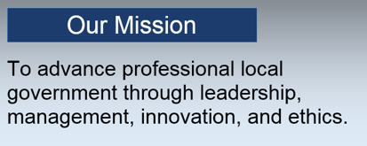
Vision & Mission
Redefining vision, mission, and values
Notes:
BOARD ACCEPTED AND APPROVED PLAN IN SEPTEMBER 2016
WORK PLAN APPROVED FEBRUARY 2017

Slide 10
Core Beliefs
Public Service
Ethics
Council Manager Form of Government and Professional Management
Equity and Inclusion
The Continuous Pursuit of Excellence
Stewardship
Leadership
Notes:
PUBLIC SERVICE: INCLUDING THE STEWARDSHIP OF DEMOCRATIC PRINCIPLES AND THE EFFICIENT AND TRANSPARENT USE OF PUBLIC RESOURCES
ETHICS: AS THE CORE OF PROFESSIONALISM IN LOCAL GOVERNMENT LEADERSHIP AND MANAGEMENT AS OUTLINED IN THE ICMA CODE OF ETHICS
COUNCIL MANAGER FORM OF GOVERNMENT AND PROFESSIONAL MANAGEMENT: AS THE PREFERRED LOCAL GOVERNMENT STRUCTURE
EQUITY AND INCLUSION: ENSURING THAT LOCAL GOVERNMENTS ARE INCLUSIVE AND MIRROR THE DIVERSITY IN COMMUNITIES
THE CONTINUOUS PURSUIT OF EXCELLENCE: INCLUDING PROFESSIONAL DEVELOPMENT, LIFE-LONG LEARNING, NETWORKING, CAPACITY BUILDING, KNOWLEDGE SHARING AND ENGAGEMENT
STEWARDSHIP: BALANCING RESOURCES INCLUDING PEOPLE, FINANCIAL, SOCIAL CAPITAL AND ENVIRONMENTAL SO THAT COMMUNITIES ARE BETTER THAN WE FOUND THEM
LEADERSHIP: DEVELOPING LEADERSHIP CAPACITY AND ATTRACTING AND DEVELOPING FUTURE GENERATIONS OF LEADERS.

Slide 11
Key Priorities
Member Benefits & Growth
Learning Community
Thought Leadership & Research Network
Advocacy and Outreach
Governance & Operations

Slide 12
Equity & Inclusion
Increase Diversity and Inclusivity
Address Structural and Institutional Barriers
Create Knowledge and Skills to Increase Equity in Local Government Operations and Public Interactions
Notes:
RECOMMENDATIONS IN THREE BROAD AREAS:
A) INCREASE DIVERSITY AND INCLUSIVITY OF ICMA
B) ADDRESS STRUCTURAL AND INSTITUTIONAL BARRIERS WITHIN ICMA, STATE ORGANIZATIONS AND OTHER AFFILIATE ORGANIZATIONS
C) CREATE KNOWLEDGE AND SKILLS TO INCREASE EQUITY IN LOCAL GOVERNMENT OPERATIONS AND PUBLIC INTERACTIONS

Slide 13
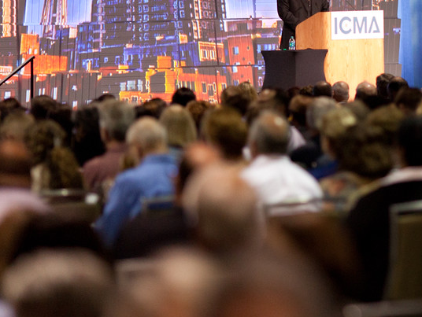
ICMA Member Overview
Over 11,000 members representing
all 50 states and 33 countries

Slide 14
Enhancing Your Membership Benefits
Resources for first time administrators and on employment agreements, CM evaluation, internship design, operational issues, best practices,etc
Free webinars on select topics with RC’s sponsorship and Ethics webinars
“Thank You For Your Loyalty”: one free webinar for all
Free e-books:
  17 Local Government Predictions for a Successful 2017
  Making it Work: The Essentials of Council-Manager Relations
  New “Smart Cities” Guide coming in 2018
Notes:
WE CONTINUE TO LOOK FOR OPPORTUNITIES TO ENHANCE THE VALUE OF MEMBERSHIP, WITH A FOCUS ON WHAT IS MOST IMPORTANT TO YOUR SUCCESS.
THANKS TO ICMA-RC WE OFFERED EXCELLENT WEBINARS ON TOPICS LIKE ETHICS, COUNCIL MANAGER RELATIONS and RETIREMENT PLANNING in 2016. THESE WILL BE OFFERED AGAIN BEGINNING IN JULY. LOOK FOR EMAILS ANNOUNCING FUTURE EVENTS.
WE VALUE YOUR MEMBERSHIP IN ICMA. AS A WAY OF SAYING THANK YOU, ALL MEMBERS WILL HAVE ACCESS TO A FREE WEBINAR OF THEIR CHOICE TO BE USED IN CALENDAR 2017. LOOK FOR AN ANNOUNCEMENT ON HOW TO ACCESS THIS LATER THIS MONTH.
IF YOU HAVEN’T DONE SO YET, PLEASE TAKE A MOMENT TO DOWNLOAD THE FREE FOR MEMBERS E-BOOK ON COUNCIL-MANAGER RELATIONS. IT IS FULL OF PRACTICAL ADVICE FROM TWO VERY SEASONED CITY MANAGERS: KEVIN DUGGAN AND MIKE CONDUFF. OVER 1,600 MEMBERS HAVE TAKEN THE TIME TO DOWNLOAD IT. AND JUST LAST WEEK, MEMBERS HAVE ACCESS TO A NEW E-BOOK ON WHAT TO EXPECT IN 2017.

Slide 15

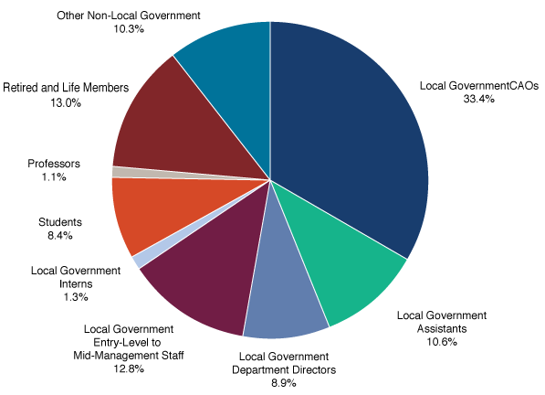
ICMA’s Inclusive Membership

Slide 16
Student Chapters
Building the Profession
79 student chapters = 1,200+ student members
27 Chapters in the Southeast Region
Does your alma mater have an ICMA Student Chapter?
Notes:
WE ARE VERY PLEASED WITH THE GROWTH OF THE ICMA STUDENT CHAPTERS. THEY ARE NOW FREE DUE TO FUNDING FROM ICMA-RC. IN ADDITION, ICMA CONTINUES TO OFFER THE ACADEMIC CO-ORDINATOR COMPLIMENTARY MEMBERSHIP IN ICMA.
WE ENCOURAGE YOU TO PROMOTE THIS WITH YOUR MEMBERS AND TO SUPPORT STUDENTS IN YOUR STATE.
WE HAVE A TARGET LIST OF OVER 90 MPA PROGRAMS THAT WE WILL BE CONTACTING THIS YEAR TO ENCOURAGE THE DEVELOPMENT OF A CHAPTER. AND WE WILL BE REACHING OUT TO OUR MEMBERS WHO ARE GRADUATES OF THE SCHOOLS TO ENCOURAGE THEIR PARTICIPATION.
VISIT ICMA.ORG UNDER CAREER RESOURCES TO SEE A COMPLETE LIST OF THE CURRENT STUDENT CHAPTERS.

Slide 17
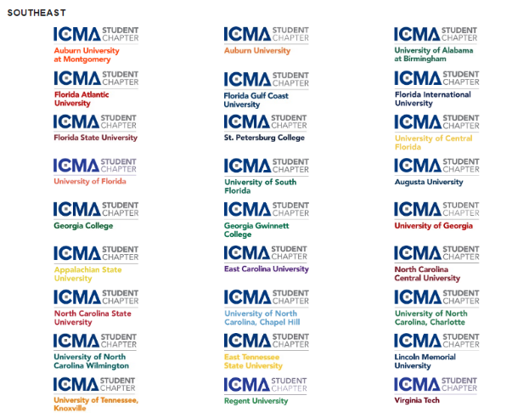
Student Chapters
Notes:
THREE STUDENT CHAPTERS IN ALABAMA. DOES YOUR ALMA MATER HAVE AN ICMA STUDENT CHAPTER?

Slide 18
ICMA Coaching
26 state associations are partners!
6 live free webinars per year
  Effective team training
Archived webinars at http://icma.org/coaching
ICMA CoachConnect
  Register / trained to Coach
  Get a coach
Notes:
SOUTHEAST COACHING PARTNERS ARE: Alabama, Florida, Georgia, Kentucky, North Carolina, and Virginia.
2017 COACHING WEBINARS
ATTRACTING AND RETAINING A DYNAMIC WORKFORCE
10-11:30 a.m. PT / 1 p.m.-2:30 p.m. ET; Wednesday, March 29 [ ✓ Done]
BEING A GREAT COACH AND A WINNING PLAYER IN YOUR ORGANIZATION
11 a.m. – 12:30 p.m. PT / 2-3:30pm ET; Wednesday, April 19 [ ✓ Done]
BEST PRACTICES IN CITIZEN/CUSTOMER SERVICE
10-11:30 a.m. PT / 1-2:30pm ET; Thursday, May 11
EFFECTIVE COMMUNICATION OF COMPLEX ISSUES TO THE PUBLIC
9–10:30 a.m. PT, / 12-1:30pm ET; Thursday, September 7
STRATEGIES FOR HAVING DIFFICULT CONVERSATIONS
10-11:30 a.m. PT / 1-2:30pm ET; Wednesday, October 11
TOOLS TO RESOLVE TOUGH ISSUES IN YOUR COMMUNITY
10-11:30 a.m. PT / 1-2:30pm ET; Thursday, November 9
COACHING IS A GREAT RESOURCE FOR EVERYONE! OUR GOAL IS TO BUILD A ROBUST AND DIVERSE COACHING GALLERY.
COACHING CAN BE A TREMENDOUS ASSET FOR EVERYONE REGARDLESS OF YOUR CAREER STAGE. SIGN UP TODAY.
ICMA ALSO HAS DEVELOPED TRAINING RESOURCES ON HOW TO BE AN EFFECTIVE COACH

Slide 19
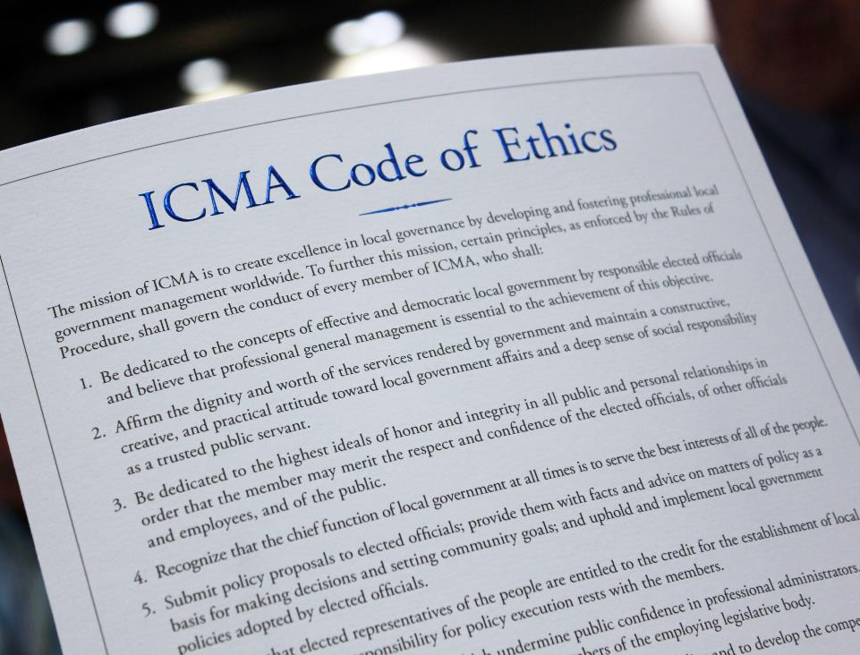
Driven by ethics and transparency
ICMA members subscribe to the
stringently-enforced Code of Ethics.
Established in 1924, the Code and its principles include government professionalism and transparency.

Slide 20
Code of Ethics
ICMA promotes the highest standards of ethical conduct in the local government management profession
Principles govern the conduct of every member of ICMA
Promoting an ethical culture is a key leadership responsibility
ICMA provides advice, education, and training
The Code is enforced through a peer review process

Slide 21
Code of Ethics: Ongoing Review
Tenet 3 revisions
  1,358 members provided feedback in November
  ICMA Committee on Professional Conduct reviewing comments to finalize recommendations this Spring
Notes:
CONTINUING THE COMPREHENSIVE REVIEW OF THE CODE:
TENET 7 WAS FINISHED in 2013
RETAINed THE TENET BUT CHANGed SOME OF THE GUIDELINES
Tenet 12 was finished in 2015. NEW TENET LANGUAGE AND NEW GUIDELINE LANGUAGE.
Tenet 3 (integrity and trust) launched at the regional summits and online.
The Committee on Professional Conduct suggested changes based on that input. Those changes were shared in a survey to members in November.
The committee reviewed your input and made recommendations to the board.
Voting on tenet 3 revisions is part of the election ballot which was emailed to all full members on may 18; voting closes june 21.

Slide 22
Code of Ethics: Tenet 4
Feedback provided at all Regional Summits this spring
  How does local government serve the best interests of all the people all the time?
  Should we retain a guideline on length of tenure?
Notes:
CONTINUING THE COMPREHENSIVE REVIEW OF THE CODE:
Next up is tenet 4
THIS IS A PARTICULARLY INTERESTING TIME TO TACKLE TENET 4
“Recognize that the chief function of local government at all times is to serve the best interests of all of the people.”
GUIDELINE IS ON Length of Service. I.E. - A minimum of two years generally is considered necessary in order to render a professional service to the local government.
WHEN ASKED, PLEASE TAKE THE TIME TO OFFER YOUR INPUT.

Slide 23
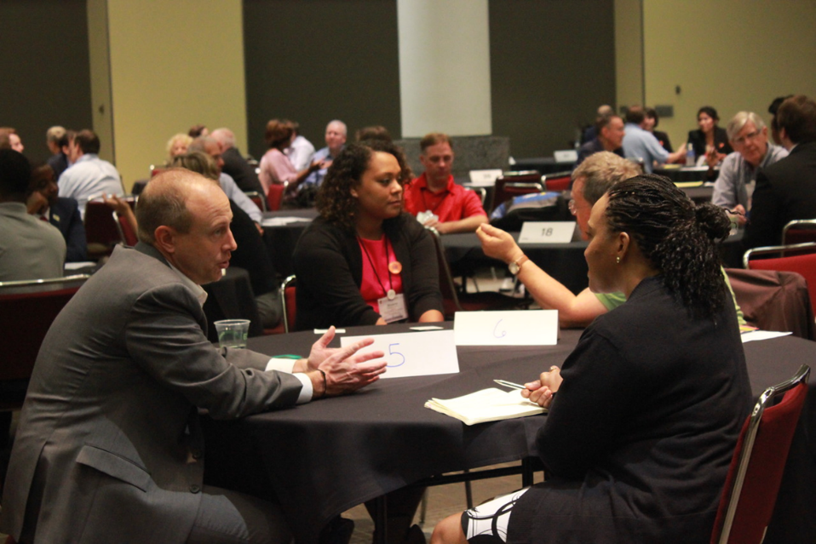
Leadership & Professional Development
Get on the Path to LIFELONG LEARNING

Slide 24
Learning for Every Career Stage
Voluntary credentialing program
Leadership and management training through ICMA University
Annual Conference attracting 3,000+ local government professionals
Online learning, “Live” and “On Demand”

Slide 25


Take Your Career to the Next Level
Online Certificate Programs
Look for announcements on Local Government 301
Notes:
WHAT IS LOCAL GOVERNMENT 101?
An interactive online certificate program; it can be taken “live” or “on demand”.
Designed for new and mid-career managers, assistant managers, and career-changers new to local government, LG 101 immerses students in the challenges that confront the local government manager today.”
Taught by experienced managers and local government experts, this online certificate program is designed to impart real-life experience, best practices, and sound advice in the areas most important to a manager’s day-to-day role.
Local Government 101 goes back to the basics – grounding local government professionals in those key skills and practices that are the foundation of becoming an effective local government manager.
CORE TOPIC AREAS: Leadership / Management / Service Delivery / Budgeting / Human Resources
WHAT IS LOCAL GOVERNMENT 201?
Interactive online certificate program.
LG 101 or five years of experience in local government is a prerequisite.
Designed to help new and mid-career managers, assistant managers, and even career-changers new to local government, go beyond the basics and gain a deeper understanding of key focus areas in local government management.
Taught by a team of seasoned local government managers and experts, this program moves beyond theory and focuses on sharing experiences of how the job actually gets done.
CORE TOPIC AREAS: Effective Communication / Public Safety / Community Building / Organizational Development / Leadership

Slide 26
Great Southeast Region
Gatlinburg SE Regional Summit in April was rated outstanding and tied with West Coast as most attended
SE leads in almost all metrics of growth and professional development
Nominations of new VPs
Ed Driggers from SC*
Lane Bailey from VA
*replaces Charles Duggan of ACCMA

Slide 27

Southeast Regional Summit
Set aside dates of April 25-27, 2018
Small networking and professional development opportunity
Location TBA – FCCMA has expressed intent

Slide 28
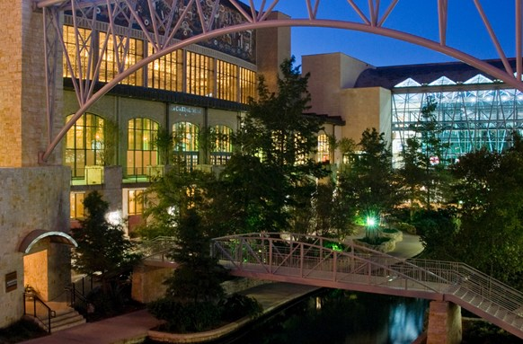
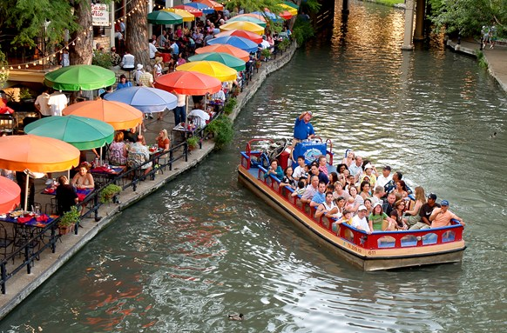
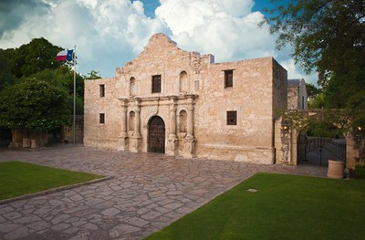
2017 ICMA Annual Conference
San Antonio / Bexar County, Texas
October 22-25, 2017

Slide 29
Conference Theme & Tracks
Building Bridges: Serving Our Whole Community
Career Tracks:
Contemporary Local Law Enforcement
Diversity, Inclusivity, and Social Justice
Emerging Technology
Preparing for and Managing 21st Century Threats
The Intersection of Personal and Professional
The National Divide
Assistant and Deputy Managers
Senior Managers/ICMA Credentialed Managers
Small-Communities Managers
County Managers
Notes:
ADDITIONAL FEE CATEGORIES
Retired and Life Members: $200
Full-Time Academic: $255
Partners: $100
Members in Transition: Complimentary (includes partner registration)
Student Member: Complimentary*
Honorary Member: Complimentary*
Senior Advisor: Complimentary*
Nonmember Speaker/Guest: Complimentary*
Children: Complimentary*

Slide 30
Conference FAQs
Housing & Registration Opens:
12noon EDT on Wednesday, June 28
Hotel reservations can be made online, via fax, or by phone
Registration Fees:
Through August 10: Member $690 (online: $665); Nonmember $1,135
Through September 21: Member $755 (online: $730); Nonmember $1,195
After September 21: Member $810 (online: $785); Nonmember $1,245
Notes:
ADDITIONAL FEE CATEGORIES
Retired and Life Members: $200
Full-Time Academic: $255
Partners: $100
Members in Transition: Complimentary (includes partner registration)
Student Member: Complimentary*
Honorary Member: Complimentary*
Senior Advisor: Complimentary*
Nonmember Speaker/Guest: Complimentary*
Children: Complimentary*
HOTELS & rates
Grand Hyatt San Antonio (headquarters) $239 single/double
Crockett Hotel $150 single/double
Hilton Palacio del Rio $209 single/double
Hyatt Regency San Antonio Riverwalk $209 single/double
La Quinta Inn & Suites San Antonio Riverwalk $149 single/double
Marriott Rivercenter $214 single/double
Marriott Riverwalk $224 single/double
Menger Hotel $145 single/double

Slide 31


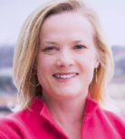
Keynotes & Featured Speakers
Sunday, October 22:
Opening Session, 3-5pm;
Rabia Siddique: Courage Under Fire
Monday, October 23:
Keynote 8:30-9:30am - Richard Florida: The New Urban Crisis
Featured Speaker 12:45-2:00pm – Stephanie Meeks: The Past & Future City
Notes:
*

Slide 32
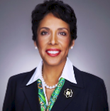
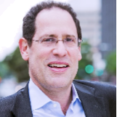
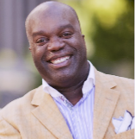
Keynotes & Featured Speakers
Tuesday, October 24:
Keynote 8:30-9:30am –
Anna Maria Chavez: True Moral Leadership
Featured Speaker 2-3:10pm –
Bruce Katz: The New Localism – How Cities
Triumph in the Age of Populism
Wednesday, October 25:
Closing Session, 8:30-10:30am –
Simon Bailey: Leading Amidst Uncertainty
Notes:
*

Slide 33
Conference FAQs
Everything you need to know:
http://icma.org/conference
Notes:
ADDITIONAL FEE CATEGORIES
Retired and Life Members: $200
Full-Time Academic: $255
Partners: $100
Members in Transition: Complimentary (includes partner registration)
Student Member: Complimentary*
Honorary Member: Complimentary*
Senior Advisor: Complimentary*
Nonmember Speaker/Guest: Complimentary*
Children: Complimentary*

Slide 34

JOIN US IN SAN ANTONIO / BEXAR COUNTY – OCTOBER 22-25

Slide 35



ICMA Voluntary Credentialing Program
A Personal Commitment to Professional Development

Slide 36
ICMA Voluntary Credentialing Program
Focuses members on life long professional learning
Promotes unique expertise that managers bring to the profession and demonstrates professionalism
Demonstrates commitment to professional development and high standards of integrity
Adds value to communities and organizations served

Slide 37


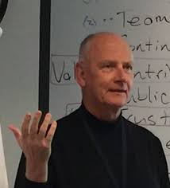
Gives you preferred registration for the ICMA Gettysburg, Williamsburg and SEI Leadership Institutes

Slide 38
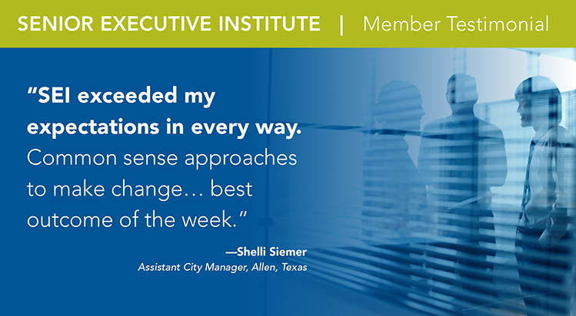
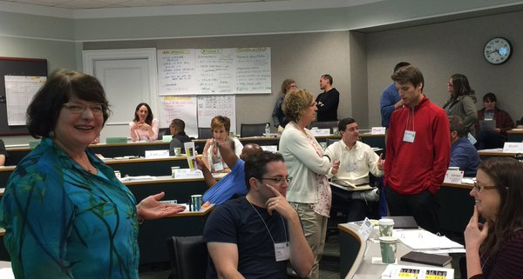

Slide 39
Credentialing Program Background
ICMA Executive Board adopted policy outline of program at July 2001 meeting
First credentials were granted by the Executive Board at May 2002 meeting
The program has grown from an initial group of 75 to over 1,400 ICMA Credentialed Managers and Candidates

Slide 40
Credentialing Eligibility Requirements
ICMA Full Member
Meet education and experience criteria
Have Applied Knowledge Assessment results that are less than 3 years old
Committed to professional development

Slide 41
Credentialed Manager Education & Experience Requirement
MPA and 7 years of local government executive or deputy/assistant experience
Other Masters and 8 years
Baccalaureate and 9 years
Less than Baccalaureate and 15 years (CAO experience only)
Local government department head experience receives half credit
CEO experience from other sectors may receive half credit

Slide 42
Credentialed Manager Candidate Education & Experience Requires.
MPA and 5 years of local government executive or deputy/assistant experience
Other Masters and 6 years
Baccalaureate and 7 years
Less than baccalaureate and 13 years (CAO experience only)
Local government department head experience receives half credit
CEO experience from other sectors may receive half credit

Slide 43
Executive Experience Definition
The professional role must include all of the following executive level responsibilities in local government:
  Staff management
  Financial management
  Policy facilitation and implementation
  Service delivery

Slide 44
Applied Knowledge Assessment
Self-assessment of knowledge; 116 questions
Takes 1.5 to 2 hours to complete online
You can save and return later as needed
Confidential, topical scoring is provided immediately

Slide 45
Credentialing Application Process
Complete AKA and receive results
Submit application (which includes professional development plan based on AKA results)
CA Board reviews after application deadline
Recommended names are listed in newsletter for member review
Approval is granted by executive board 3 months after application deadline
ICMA offers lapel pin, certificate and sample press release

Slide 46
How Do I Apply for the Credential?
The easiest way to apply is online:
Sign in at icma.org and click on My Account
Select Credentialing Apply/Renew from the Credentialing dropdown menu
Click on Apply
2017 deadlines are January 3, April 3, July 3, and October 2

Slide 47
What is the Cost?
$50 for online application
The Applied Knowledge Assessment is $75 and can be ordered at webassessor.com/aka (you can also access this link through the Credentialing section of icma.org)

Slide 48
Professional Development Plan
Includes:
  Learning goal(s)
  Potential Activities
Ensures conscious intent and focus
Visit Credentialing Resources section of icma.org for sample plans, recommended reading, etc.

Slide 49
Maintaining the Credential
Maintain ICMA Membership
Submit annual report online outlining professional development and what you learned
  Annual reports are due one year after approval, on the first day of the month
  Instructions are e-mailed starting three months in advance of the deadline
Complete a multi-rater assessment at least once every 5 years

Slide 51
For more information…
E-mail credentialing@icma.org
Jenese Jackson, Credentialing Program Manager, will be happy to help.

